Slide 1
Location & Map
1604C19H – Emerging Technology
Week 14

Slide 2
In This Tutorial
This article will discuss about several things that related with location and a map
We will obtain our current location
We will show a map with our position at the center of the map
We will monitor a Taxi movement in the map.

Slide 3
Preparation
Create a new stateful screen, name it MyMap (mymap.dart)
Add a menu to access this screen

Slide 4

mymap.dart
class _MyMapState extends State<MyMap> {
@override
Widget build(BuildContext context) {
return Scaffold(
appBar: AppBar(
title: const Text("Map test"),),
body: Column(
mainAxisAlignment: MainAxisAlignment.center,
children: <Widget>[],),
);
}
}
class MyMap extends StatefulWidget {
const MyMap({super.key});
@override
State<MyMap> createState() => _MyMapState();
}

Slide 5
Getting Location
Sometimes our app need a data of our current location in the world. Usually in form of longitude (X) and latitude (Y). For example :
- App that can record location when taking a picture using camera.
- App that check our position to enable or disable some other features, for example to enable check-in button when we are around a specific location

Slide 6
Location Plugin
Here, we will use Flutter Location Plugin to get our X,Y location. https://pub.dev/packages/location
Installation, in pubspec.yaml:
location: ^8.0.1
Importing:
import ‘package:location/location.dart’;

Slide 7
Variables
We will store X,Y in two variables _xMarker and _yMarker, initialized with 0. Also we prepare another x,y for map center (will be used later).
double _xCenter = 0;
double _yCenter = 0;
double _xMarker = 0;
double _yMarker = 0;
Show the location in a simple widget:
Center(child: Text(" $_xMarker, $_yMarker")),

Slide 8
_getXY()
void _getXY() async {
Location location = Location();
bool serviceEnabled;
PermissionStatus permissionGranted;
LocationData _locationData;
serviceEnabled = await location.serviceEnabled();
if (!serviceEnabled) {
serviceEnabled = await location.requestService();
if (!serviceEnabled) {
return;
}
}
permissionGranted = await location.hasPermission();
if (permissionGranted == PermissionStatus.denied) {
permissionGranted = await location.requestPermission();
if (permissionGranted != PermissionStatus.granted) {
return;
}
}
_locationData = await location.getLocation();
setState(() {
_yMarker = _locationData.latitude!;
_xMarker = _locationData.longitude!;
});
}

Slide 9
Init State
The variables will be updated with a function _getXY() (will be declared later). Call it at initState().
@override
void initState() {
super.initState();
_getXY();
}

Slide 10
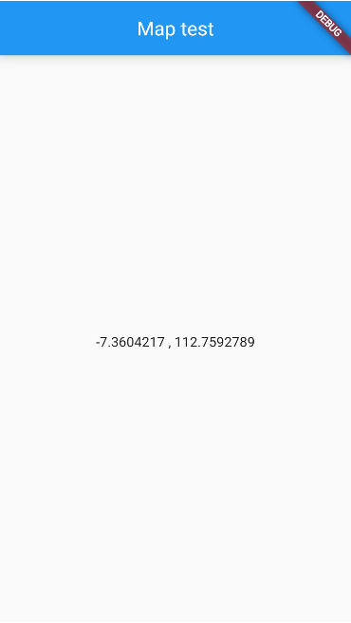
Test
The first time this screen is loaded, Android will ask the location permission. Allow it

Slide 11
DISPLAYING MAP

Slide 12
Displaying Map
Some applications shows a map for specific purpose, for example to show some of thematic data location such as stores, hotel, tourist attraction, etc., and sometime also the user current location. There are several plugin for showing map. Here we will use flutter_map and latlong2 plugins

Slide 13
Plugins
https://pub.dev/packages/flutter_map
https://pub.dev/packages/latlong2
Add to pubspec.yaml:
flutter_map: ^8.2.2
latlong2: ^0.9.1
Imports as necessary:
import "package:flutter_map/flutter_map.dart";
import "package:latlong2/latlong.dart";

Slide 14
Building Map
Add a new function that displays a Map with a marker as a center that is taken from our current position which already obtained in previous section.
To recenter map, it will need a controller. The map will have 2 layers, the first layer is OpenStreetMap as a base layer, and the second is a point marker layer represented in an heart icon for showing our location.

Slide 15
final MapController mapCon = MapController();
Widget _buildMap() {
return FlutterMap(
mapController: mapCon,
options: MapOptions(
initialCenter: LatLng(_yCenter, _xCenter),
initialZoom: 16,
),
children: [
TileLayer(
urlTemplate: 'https://tile.openstreetmap.org/{z}/{x}/{y}.png',
userAgentPackageName: 'com.example.hello_flutter',
),
MarkerLayer(
markers: [
Marker(
point: LatLng(_yMarker, _xMarker),
width: 24,
height: 24,
child: const Icon(
Icons.favorite,
color: Colors.pink,
size: 24,
),
),
],
),
],
);
}

Slide 16
Add Widget
Add the _buildMap widget function below the X,Y Text
body: Column(
mainAxisAlignment: MainAxisAlignment.center,
children: <Widget>[
Text(" $_xMarker, $_yMarker"),
SizedBox(height: 400, child: _buildMap()),
],
),

Slide 17
Center Map
Set _xCenter and _yCenter with the same value with our current position, and then re-center the map using move method in the map controller. This code is placed in setState block when we got our X,Y position.
setState(() {
_yMarker = _locationData.latitude!;
_xMarker = _locationData.longitude!;
_yCenter = _locationData.latitude!;
_xCenter = _locationData.longitude!;
mapCon.move(LatLng(_yCenter, _xCenter), mapCon.camera.zoom);
});

Slide 18
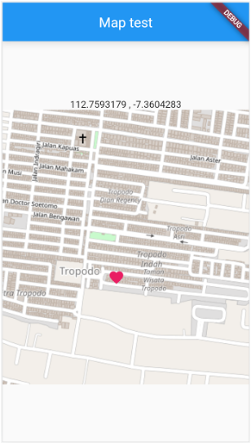
Result
Depending on your current location, your result may differ with what shown here
Make sure that the location service is turned on!

Slide 19
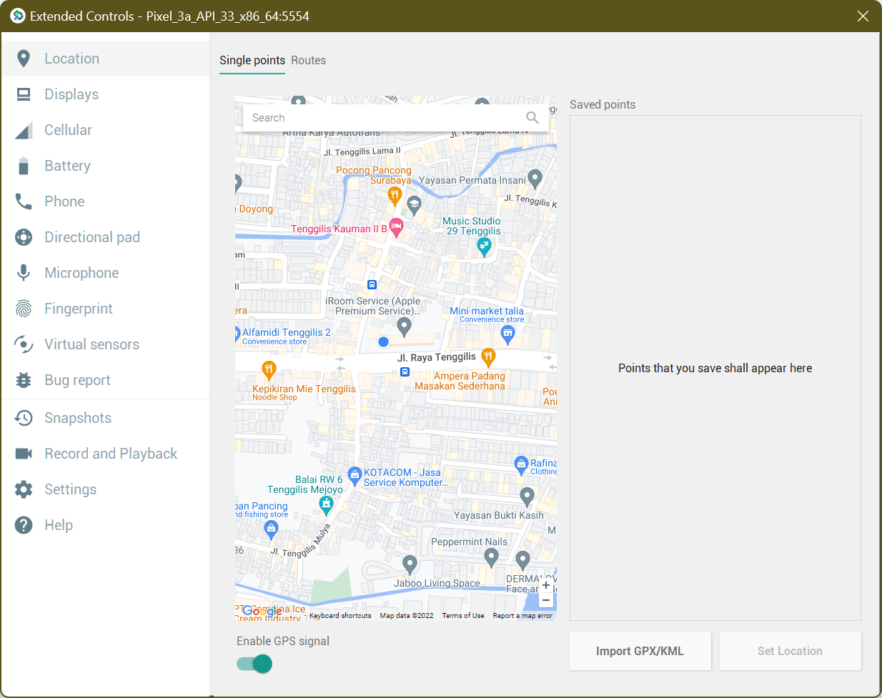
Using Emulator?
If your map points to somewhere else you don’t recognize, it’s because the emulator’s location is set to Googleplex by default
Change it first in Extended Controls to your location manually (don’t forget to click Set Location)

Slide 20
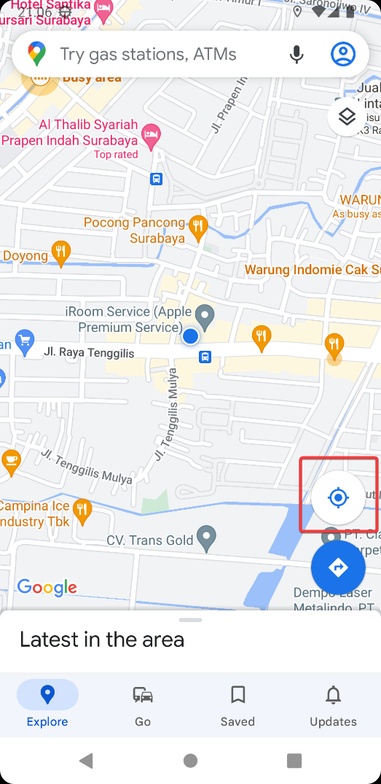
Still pointing to Googleplex?
If somehow your emulator still points to Googleplex, try these steps:
Open Google Maps (don’t forget to allow location)
Set to current location (you might need to click the location button)
Go back to your app and reopen the MyMap screen

Slide 21
REALTIME POSITION

Slide 22
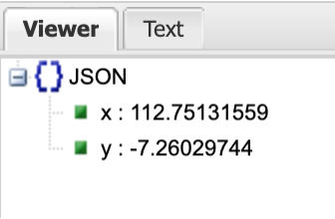
Realtime Position
Several popular application nowadays have a screen that show a real time position of something time by time in the map. For example: Grab, Gojek, or online taxi app that show us the location of the car when heading to our position or when it bring us to a certain destination.
We will try to show this kind of object, but with a dummy data. This data is represent a taxi position that moving time by time around Surabaya University. The web service can be access at:
https://ubaya.cloud/posisi_xy.php
The output form is very simple JSON like this:

Slide 23
Preparation
Before reading the web service, we will prepare a Timer first. The Timer will tick and read the web service in certain interval, for example in a second.
But before reading the web service, let’s try something simple first: adding _xMarker value periodically.

Slide 24
The Functions
Create these two functions, first function is the Timer, and the second is a function that is called in the timer tick (every second). Later, this second function will be used for calling the web service (here is the dummy web service) and redraw the interface including the map and its objects. Therefore this second function use setState.
In our first experiment, it just adds the _xMarker value with a little number (in degree) to make our marker moves to the east every second.
late Timer _timer;
startTimer() {
_timer = Timer.periodic(const Duration(milliseconds: 1000), (timer) {
updateMap();
});
}
updateMap() {
setState(() {
_xMarker = _xMarker + 0.0005;
});
}
@override
void dispose() {
_timer.cancel();
super.dispose();
}

Slide 25
Call and Run
Call the timer in initState()
void initState() {
super.initState();
_getXY();
startTimer();
}
Run and check the result. If the marker moves to the east every second, our functions are ready to use.

Slide 26
Using Web Service
Now we are ready to use the web service. Make sure that the http package is installed.
We will use the Surabaya University hall as our map. In order to view the “taxi” movement, we need to make the map centered around Surabaya . Update the _xCenter and _yCenter with these values:
double _yCenter = -7.320240;
double _xCenter = 112.767747;

Slide 27
Changes
Set the zoom level of the map to a lower value:
mapController: mapCon,
options: MapOptions(
initialCenter: LatLng(_yCenter, _xCenter),
initialZoom: 15,
),
Remove the lines that set _xCenter and _yCenter to current location.

Slide 28
Taxi Location and Image
Add two variables to track taxi location
double _xTaxi = 0;
double _yTaxi = 0;
We need a new Marker object in the map that use this position. We use a taxi image for showing the marker. You can download it from https://ubaya.cloud/flutter/fikri/redcar.png or from another sources. Add it as an image asset or use network.
Marker(
point: LatLng(_yTaxi, _xTaxi),
width: 30,
height: 30,
child: Image.network(
'https://ubaya.cloud/flutter/fikri/redcar.png',
fit: BoxFit.contain,
),
),

Slide 29
Update Map with JSON
We update the updateMap function to call the webservice and then put the JSON value to _xTaxi and _yTaxi.
updateMap() async {
final response = await http
.post(Uri.parse("https://ubaya.cloud/posisi_xy.php"));
if (response.statusCode == 200) {
print(response.body);
Map json = jsonDecode(response.body);
setState(() {
_xTaxi = json['x'];
_yTaxi = json['y'];
});
}
}

Slide 30
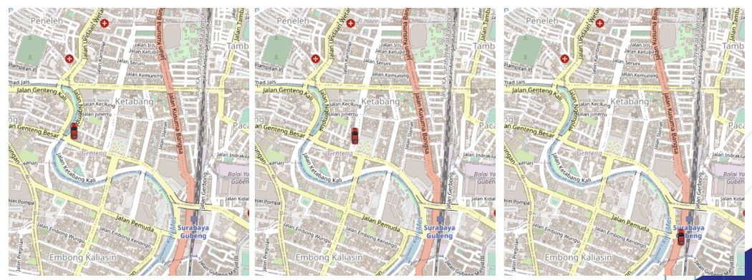
Test
The taxi is shown as moving, but it always faces North

Slide 31
Refining Car Facing
We will refine the taxi direction by rotating the asset image based on its previous location and current location. We will need 3 new variables:
double _xTaxiPrev = 0;
double _yTaxiPrev = 0;
double _angleTaxi = 0;
For rotating image, we use Transform.rotate widget which wrap our previous Image.assets
child: Transform.rotate(
angle: _angleTaxi,
child: Image.network(
"https://ubaya.cloud/flutter/fikri/redcar.png",
width: 30,
),
),

Slide 32
Update location
We put the calculation after reading web service for the new Taxi location
setState(() {
_xTaxiPrev = _xTaxi;
_yTaxiPrev = _yTaxi;
_xTaxi = json['x'];
_yTaxi = json['y'];
double temp = Math.atan((_xTaxi - _xTaxiPrev) / (_yTaxi - _yTaxiPrev));
if (_yTaxi < _yTaxiPrev) temp = Math.pi + temp;
if (!temp.isNaN) _angleTaxi = temp;
});

Slide 33
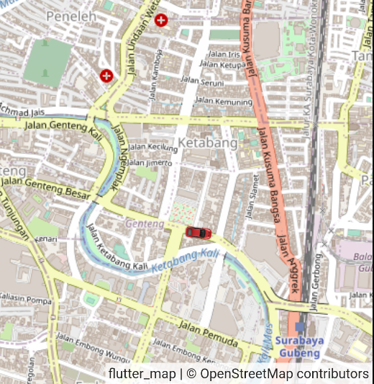
Result
Now our taxi will face the correct direction

Slide 34
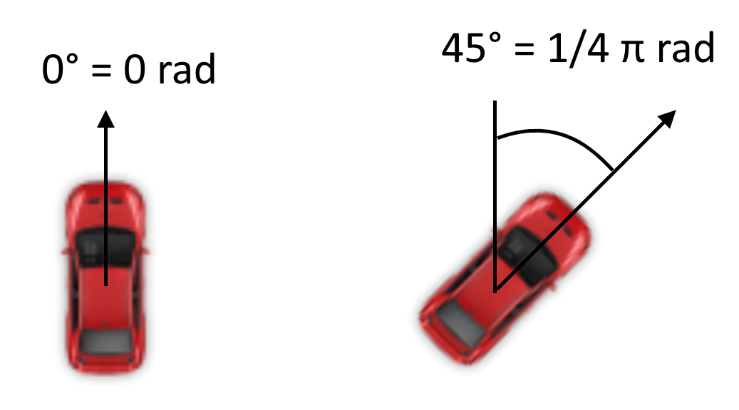
The Math
So, how do we calculate the correct angle for the taxi? Using trigonometry.
In Flutter, a 0 rad (0°) rotation points North, and a positive value rotates clockwise around its origin (center)

Slide 35
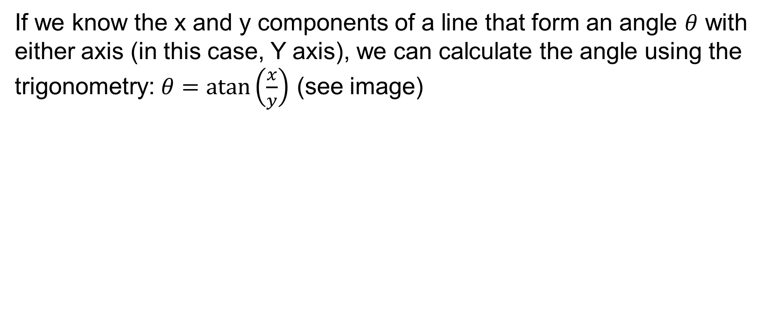
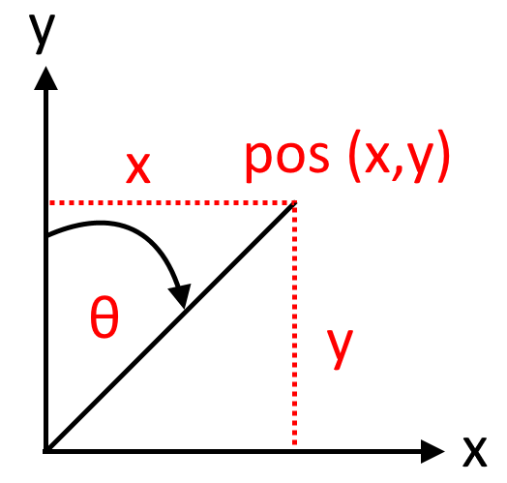
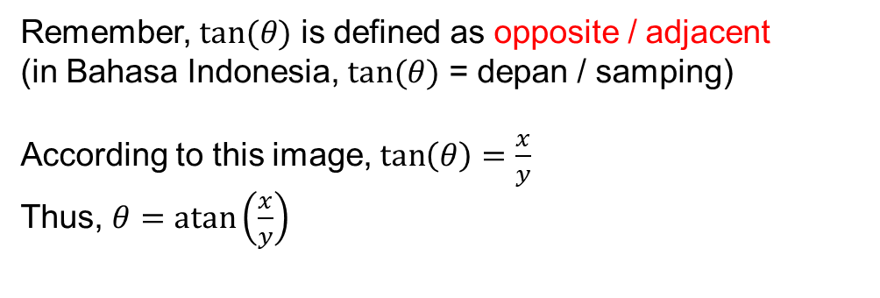
The Trigonometry: atan

Slide 36
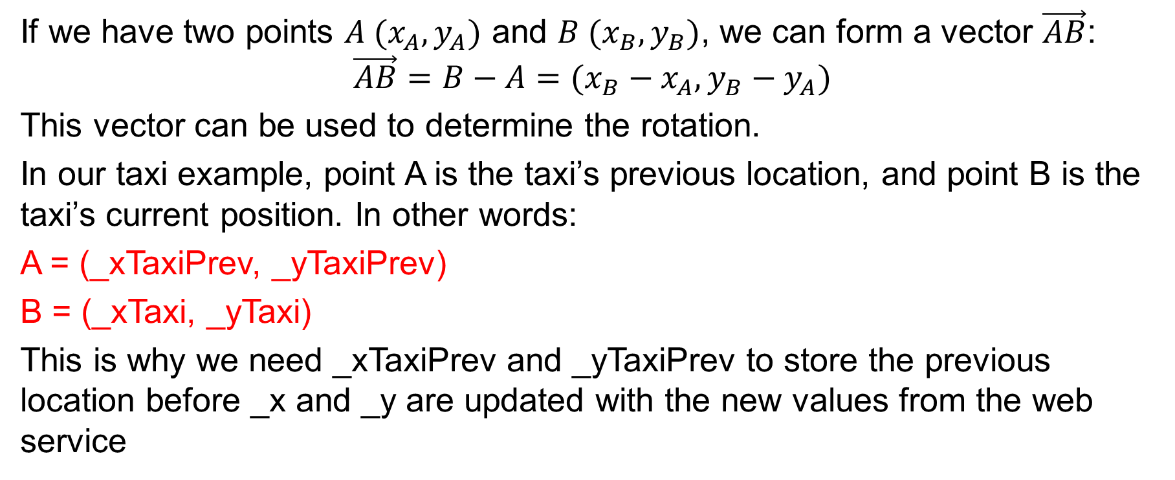
Forming the direction vector

Slide 37
Direction Angle
From our vector, we know that:
x = _xTaxi - _xTaxiPrev;
y = _yTaxi - _yTaxiPrev;
Putting them altogether, we get this code:
double temp = Math.atan((_xTaxi - _xTaxiPrev) / (_yTaxi - _yTaxiPrev));
However, the atan() function returns -Math.pi/2 to Math.pi/2, or in degrees, -90 to 90. This means that the rotation can never point down (90 to 270 degrees)

Slide 38
When it points down…
If we need to rotate downward, then we need to add Math.pi radians (180 degrees) to the angle
How do we know if we need to rotate downward? Compare current y (_yTaxi) with previous y (_yTaxiPrev). If _yTaxi is smaller than _yTaxiPrev, we know that our taxi moves down, thus the image needs to point down or rotated extra 180 degrees (Math.pi).
Thus:
if (_yTaxi < _yTaxiPrev) temp = Math.pi + temp;

Slide 39
What is NaN?
The last line of the code says:
if (!temp.isNaN) _angleTaxi = temp;
Why this checking? There is a possibility in calculating atan() that y = 0, thus creating an undefined number (x / 0 = undefined). When this happens, atan() returns NaN: Not a Number.
If we feed NaN to angle property of Transform.rotate widget, it will complain. To prevent this, we don’t store the rotation angle if temp is NaN.

Slide 40

This tutorial is based on https://daniel-hp.medium.com/flutter-shows-realtime-position-in-map-with-the-car-facing-forward-following-the-direction-6c55fe3d3101

